Slide 1











Courier Shipping Management System
Utsav Solanki

Slide 2

Functional Requirements

Slide 3

Functional Requirements
One employee can work on many couriers. One courier is handled by many employees. -> (M to N)
One promotion can be applied to many vehicles -> (1 to N)
Customers cannot exist without couriers.
Couriers cannot exist without a vehicle , customer , branch and delivery partner.
A branch must have at least one employee and Employees must have a branch.
Payment cannot exist without courier.
One delivery partner can deliver many couriers. -> (1 to N)
One customer can order many couriers(ReferenceID) -> (1 to N)
One Vehicle delivers many couriers(ReferenceID) -> (1 to N)
One customer can give many feedbacks -> (1 to N)
One Branch handles many couriers. -> (1 to N)
One payment is associated with only one courier.(1 to 1)
One Branch can have multiple employees. -> (1 to N)
One Employee can work with only one branch. -> (1 to 1)
Read More

Slide 4

ER-Model

Slide 5
Click Below icon to view the ER - Diagram
ER Model

Slide 6

Relational Model

Slide 7
Click Below icon to view the Relational - Diagram
Relational Model

Slide 8

SQL DDL Statements And Special Feature

Slide 9
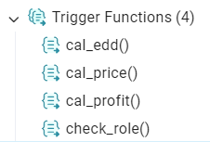
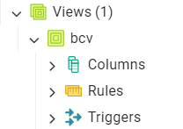
Check Constraints
Trigger
CHECK (length(Pincode::text) = 6)
CHECK (Vehicle_id ~ '^[A-Z]{2}[0-9]{2}[A-Z]{1,2}[0-9]{4}$’)
CHECK (length(Contact_Number::text) = 10)
CHECK (role IN ('Driver', 'Clerk', 'IT_Support’)) – For Employee Table
CHECK (Contact_Of_Sender <> Contact_Of_Receiver)
CHECK (branch_id <> to_branch)
View
To view our DDL Click Here

Slide 10
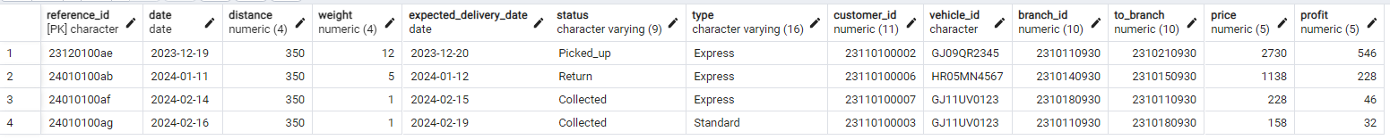
Special Feature
In our courier shipping management system, a special feature uses a trigger to automatically calculate the expected
delivery date and price based on the shipment's distance and type (e.g., Express or Standard).
This automation ensures accurate, consistent pricing and delivery estimates for each courier.

Slide 11

Queries

Slide 12
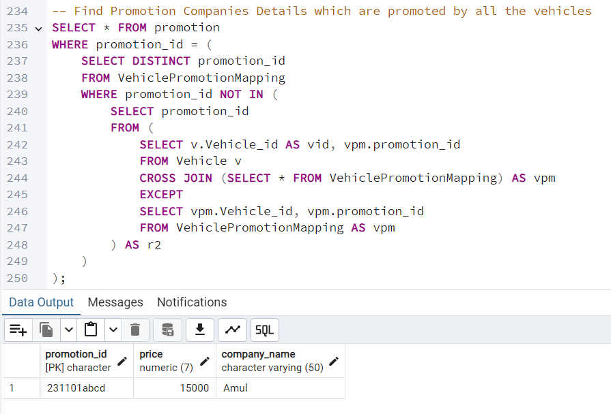
Query - 1
Find Promotion Companies Details which are promoted by all the vehicles

Slide 13
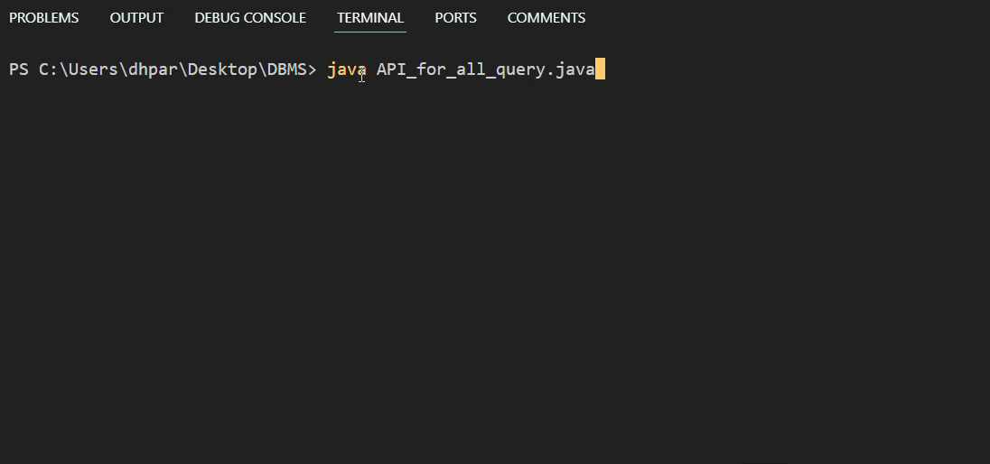
Query – 1 using API call (Java)

Slide 14
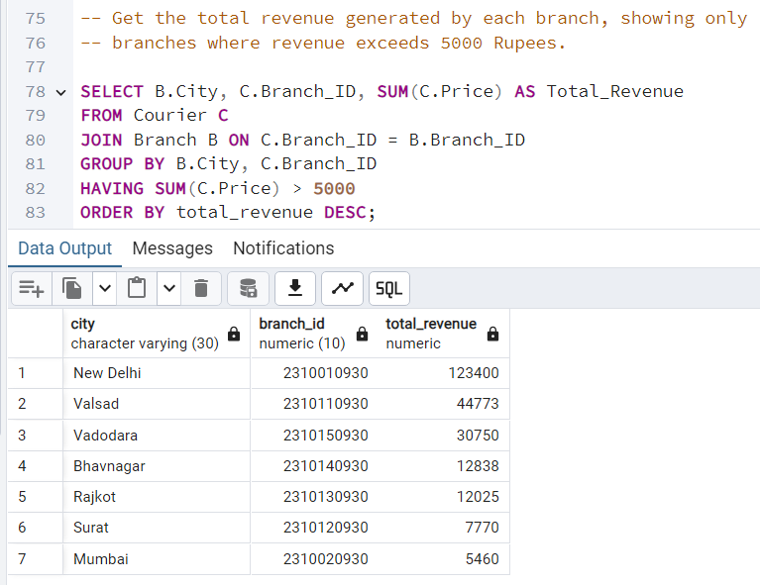
Query - 2
Get the total revenue generated by each branch, showing only branches where revenue exceeds 5000 Rupees.

Slide 15
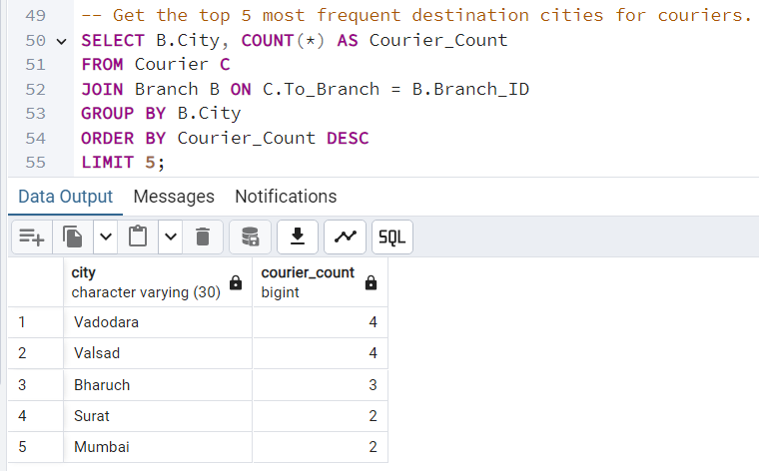
Query - 3
Get the top 5 most frequent destination cities for couriers.

Slide 16
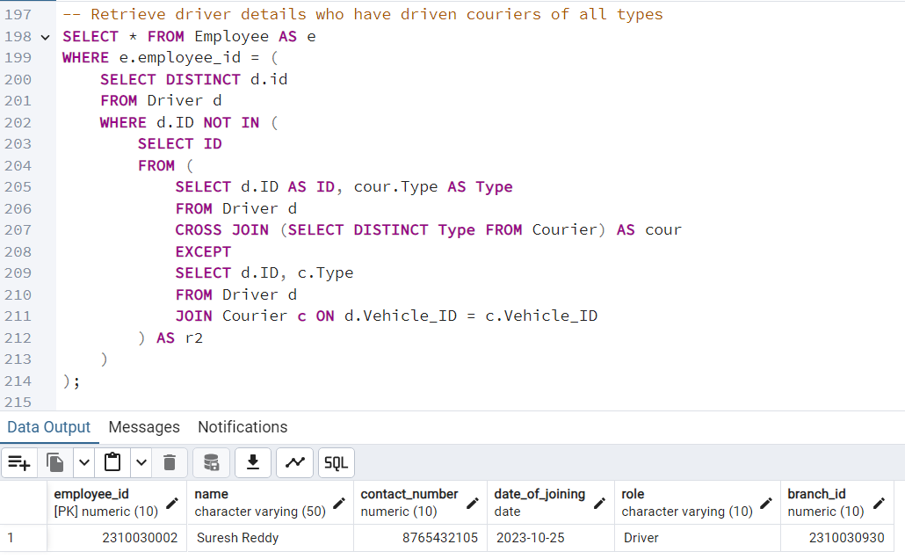
Query - 4
Retrieve driver details who have driven couriers of all types

Slide 17
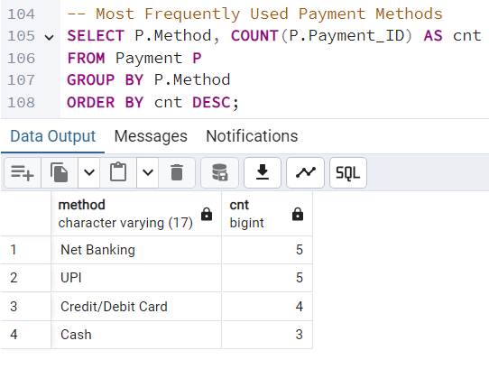
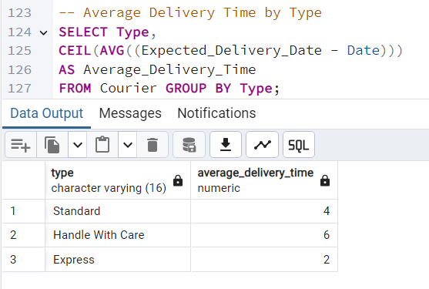
Query - 5
Most Frequently Used Payment Methods
Average Delivery Time by Type

Slide 18

Remarks
For Now, I do vehicle assignment manually. In Future, I can implement vehicle assignment utilizing Dijkstra's algorithm for efficient route selection, combined with triggers to automate this process within the database system.

Slide 19
Thank You

